Slide 1
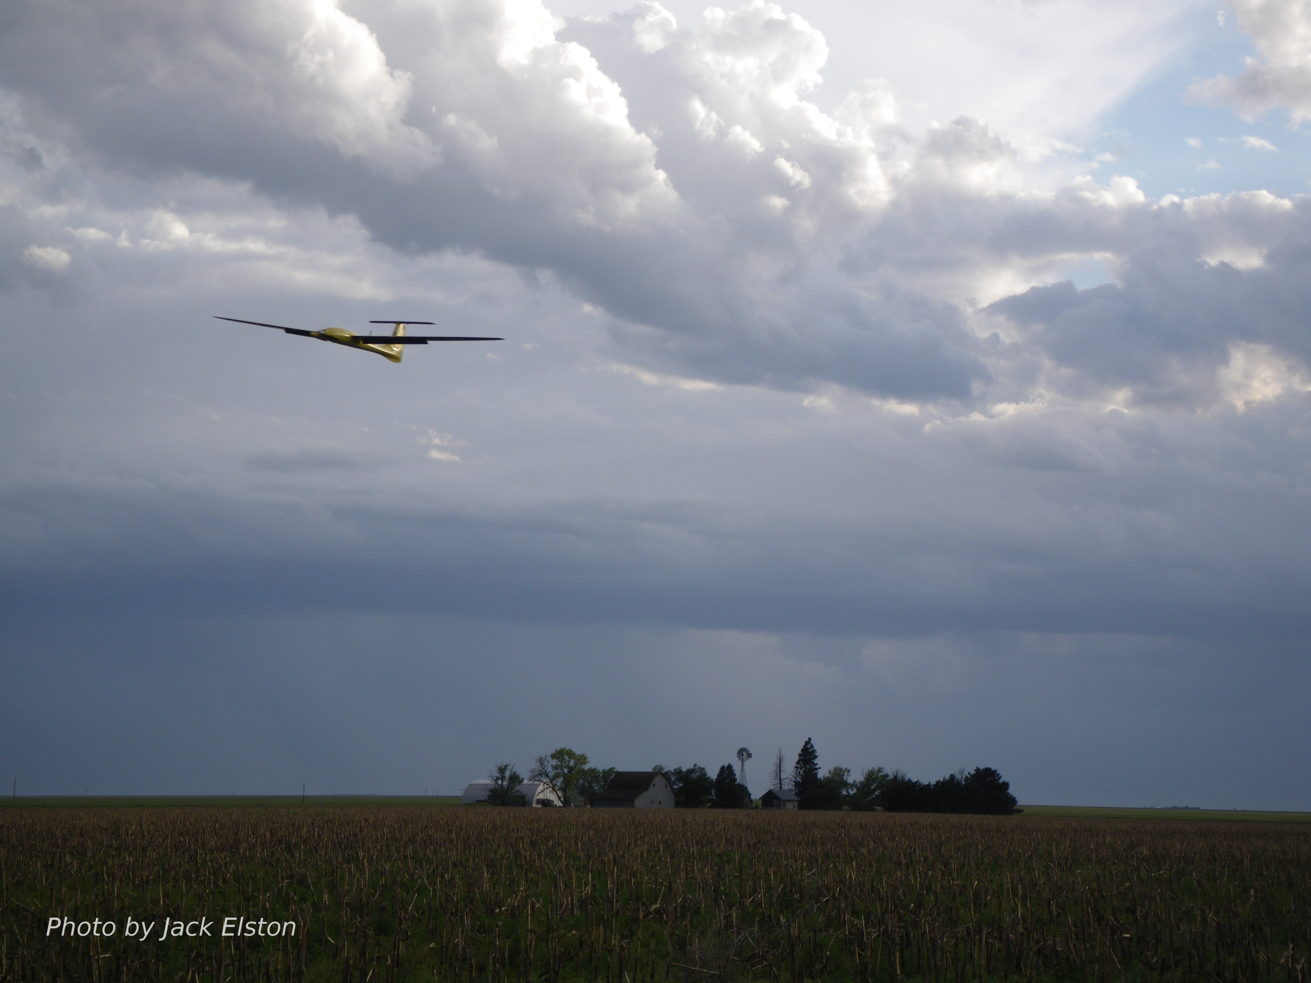
Chapter 8
State Estimation

Slide 2
Architecture

Slide 3
Why estimate states?
State information needed to control aircraft
We measure many things
accelerations, angular rates, pressure altitude, dynamic pressure (airspeed), magnetic heading (sometimes), GPS position
Don’t have direct measurements of everything we need
Notes:
\begin{table}
\centering
\begin{tabular}{|c|l|}
\hline
State & Measured directly or estimated? \\
\hline \hline
$p_n$ & Measured (GPS) and smoothed \\ \hline
$p_e$ & Measured (GPS) and smoothed \\ \hline
$p_d$ & Measured (absolute pressure, GPS) \\ \hline
$u$ & Estimated with EKF \\ \hline
$v$ & Estimated with EKF \\ \hline
$w$ & Estimated with EKF \\ \hline
$\phi$ & Estimated with EKF \\ \hline
$\theta$ & Estimated with EKF \\ \hline
$\psi$ & Estimated with EKF \\ \hline
$p$ & Measured (rate gyro) \\ \hline
$q$ & Measured (rate gyro) \\ \hline
$r$ & Measured (rate gyro) \\
\hline
\end{tabular}
\end{table} \index{State Variables}

Slide 4
Benchmark Maneuver

Slide 5
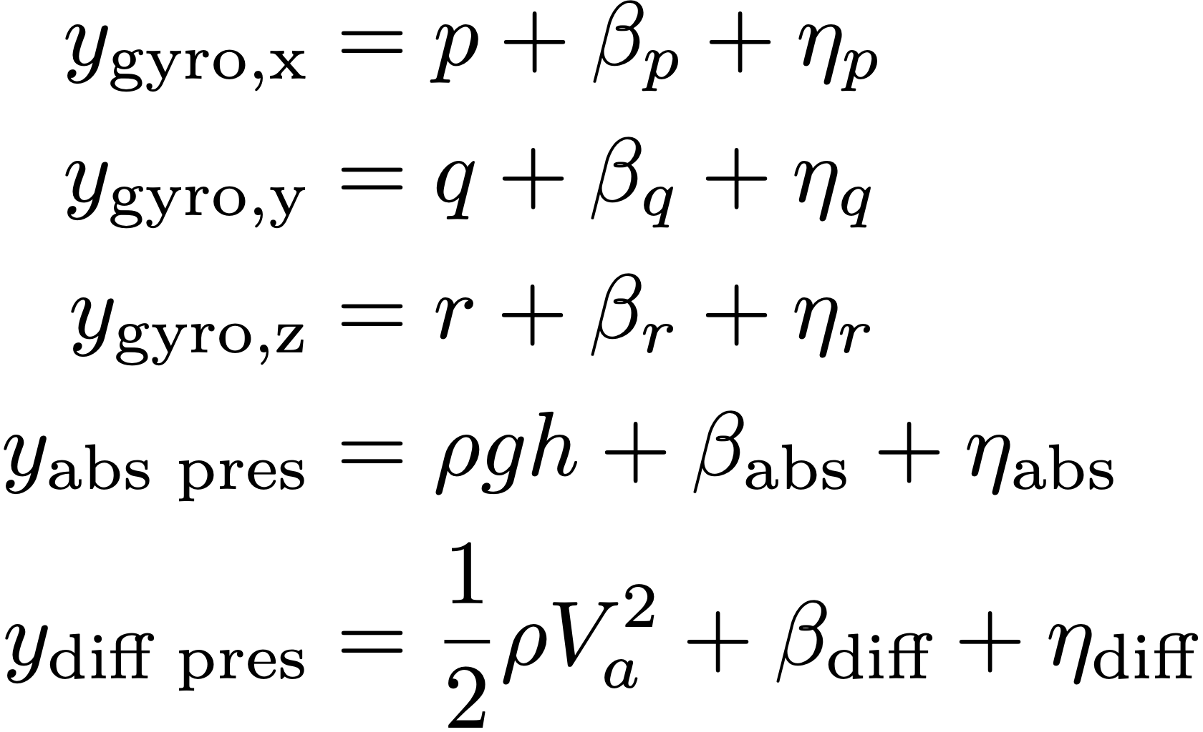
Inverting Sensor Measurement Model
Several states can be estimated by inverting sensor measurement model
Angular rates, altitude, airspeed
LPF denotes low pass filter
Mathematical Model
State Estimate
Notes:
\hat{p} &= \mathit{LPF}(y_{\text{gyro,x}}) \\
\hat{q} &= \mathit{LPF}(y_{\text{gyro,y}}) \\
\hat{r} &= \mathit{LPF}(y_{\text{gyro,z}}) \\
\hat{h} &= \frac{\mathit{LPF}(y_{\text{static pres}})}{\rho g} \\
\hat{V}_a &= \sqrt{\frac{2}{\rho}\mathit{LPF}(y_{\text{diff pres}})}
y_{\text{gyro,x}} &= p + \beta_p + \eta_p \\
y_{\text{gyro,y}} &= q + \beta_q + \eta_q \\
y_{\text{gyro,z}} &= r + \beta_r + \eta_r \\
y_{\text{abs pres}} &= \rho g h + \beta_{\text{abs}} + \eta_{\text{abs}} \\
y_{\text{diff pres}} &= \frac{1}{2}\rho V_a^2 + \beta_{\text{diff}} + \eta_{\text{diff}}

Slide 6
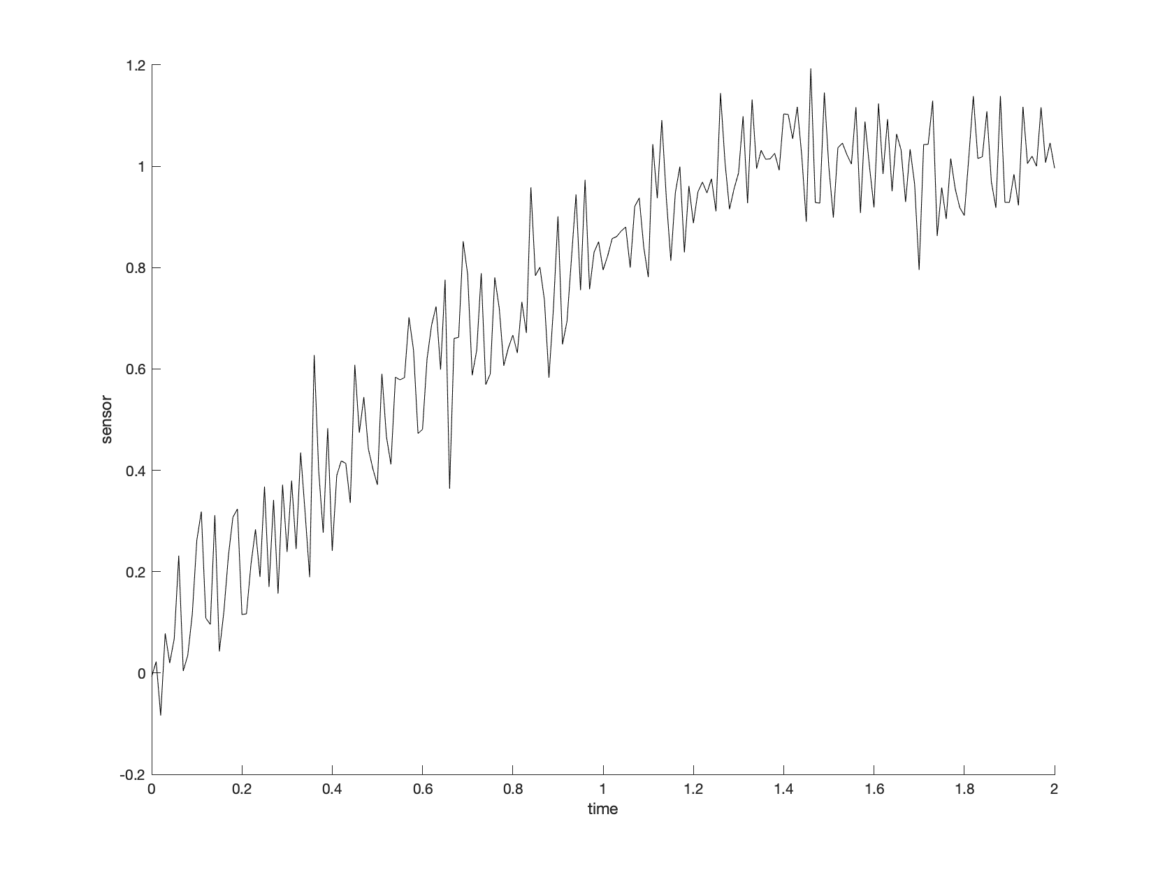
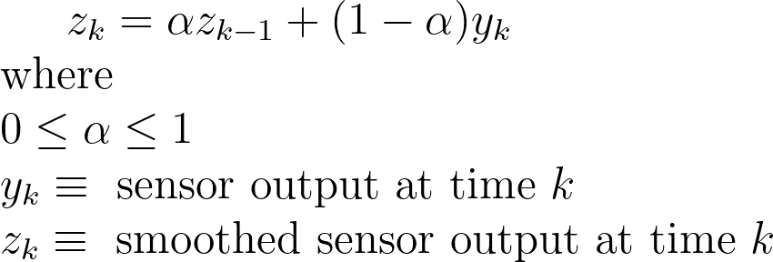
The alpha-filter
Suppose that your sensor gives noisy data as shown on the right.
The objective is to process this data to smooth out the noise.
The standard method is to use an alpha-filter:

Slide 7
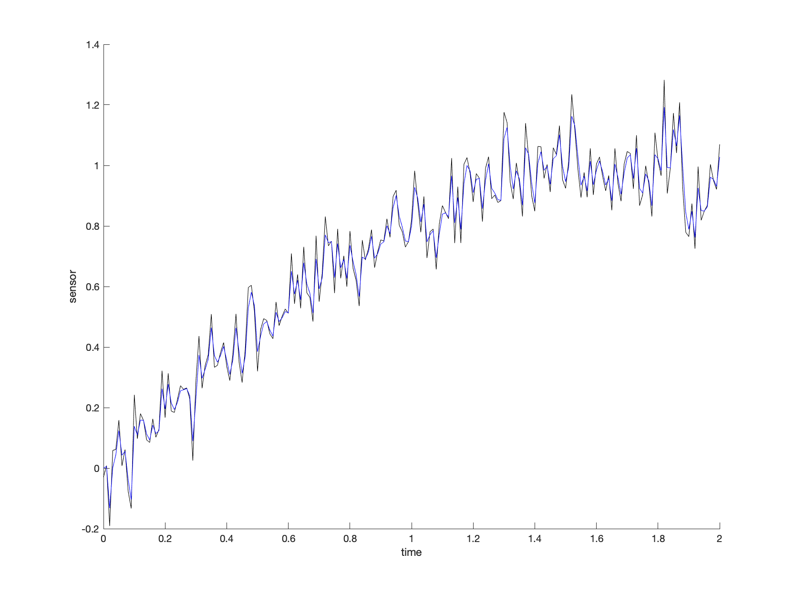
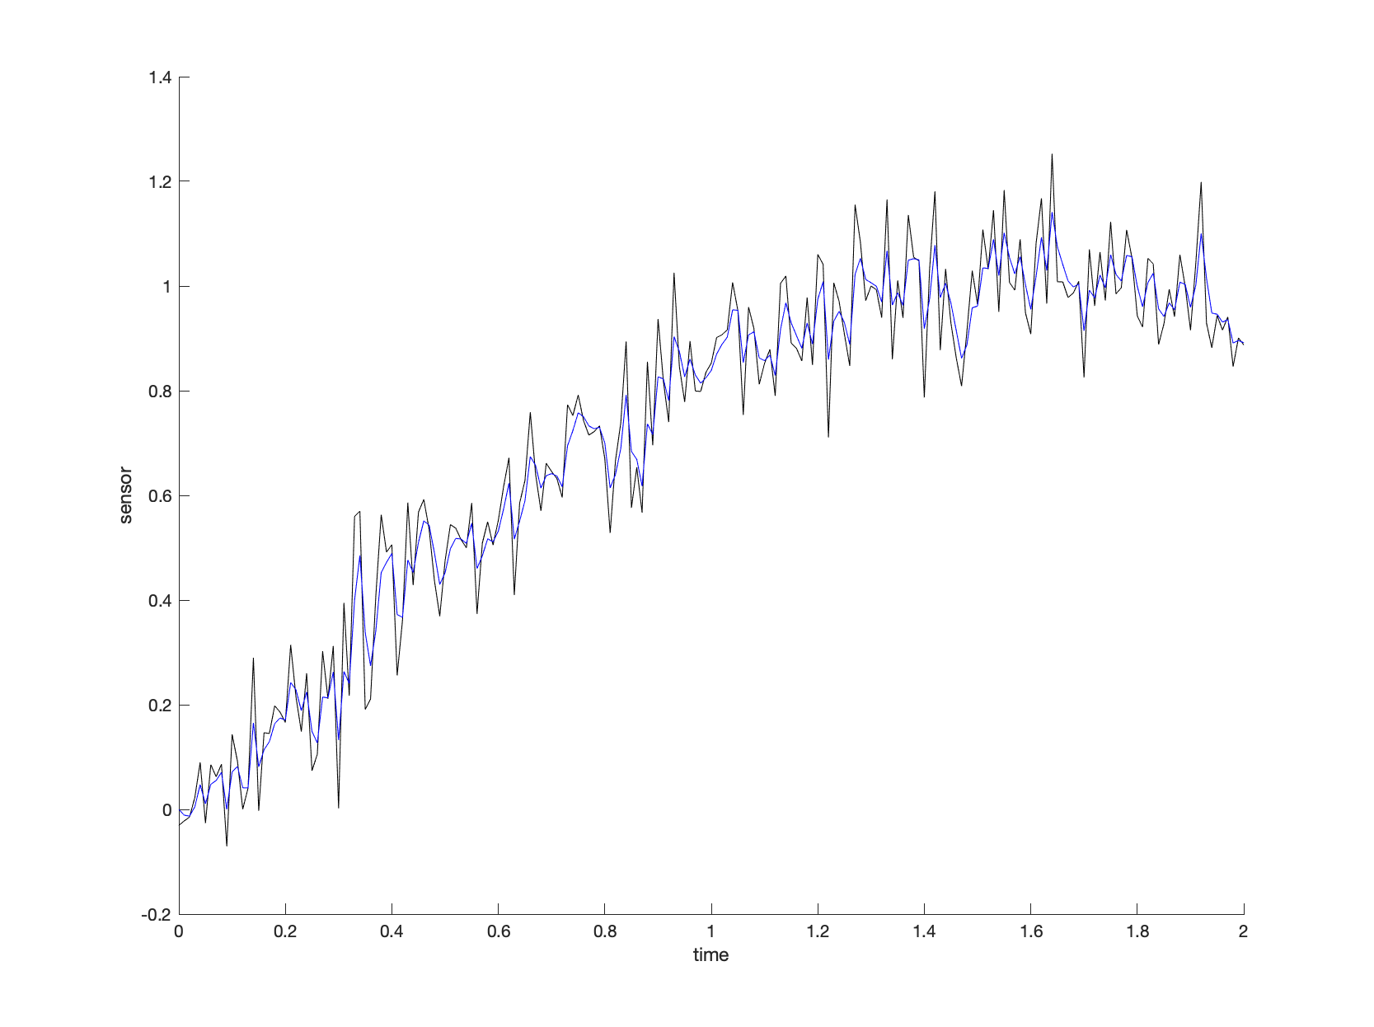
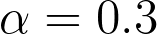
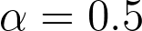
The alpha-filter

Slide 8
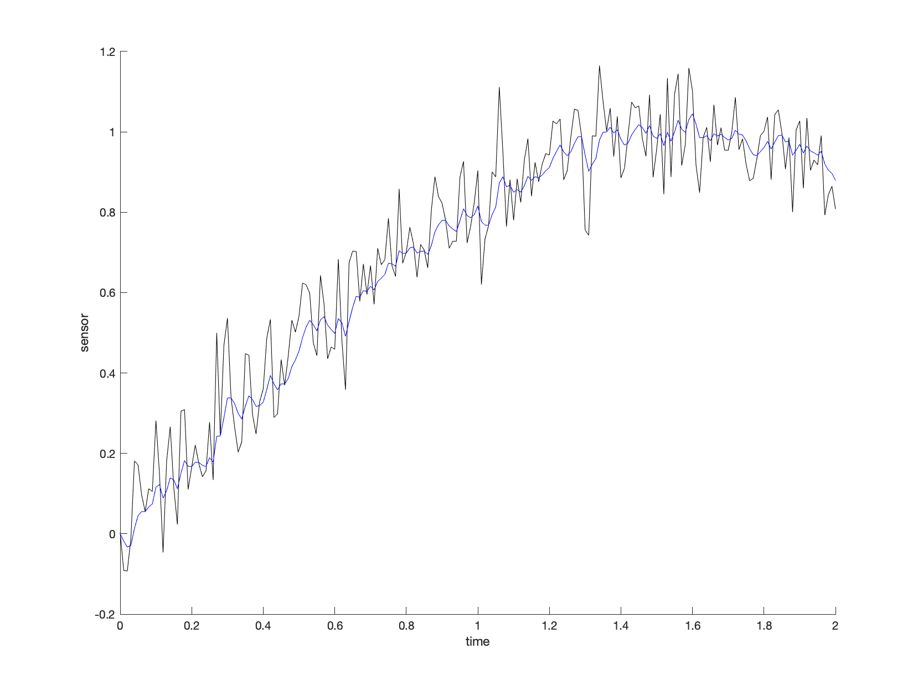
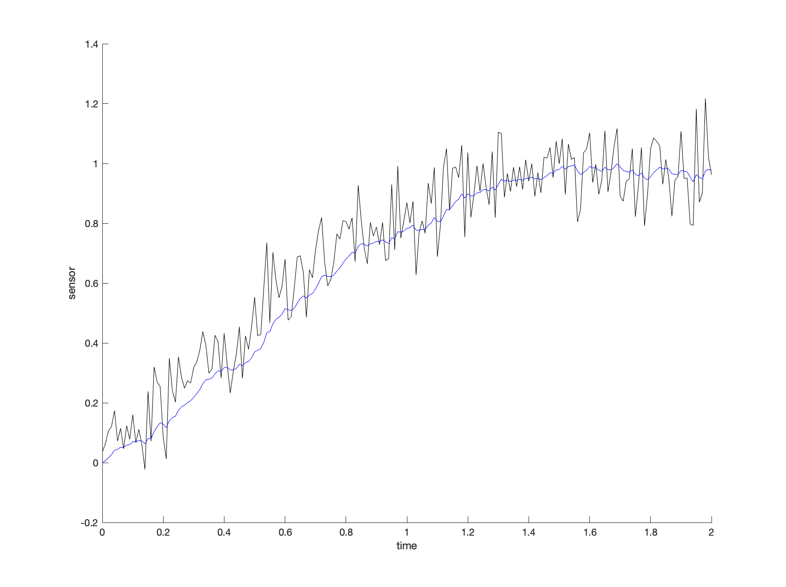
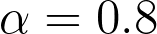
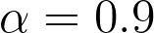
The alpha-filter

Slide 9
The alpha-filter: a deeper look
Notes:
\noindent The traditional low-pass filter is given by
\[
Z(s) = \frac{a}{s+a} Y(s),
\]
where frequencies above $a$~radians/s are "filtered."
\vspace{1cm}
\noindent The associated differential equation is
\[
\dot{z} = -a z + a y.
\]
\noindent Solving the differential equation gives
\[
z(t) = e^{-a(t-t_0)}z(t_0) + \int_{t_0}^t e^{-a(t-\tau)} a y(\tau) \,d\tau
\]

Slide 10
The alpha-filter: a deeper look
Notes:
\noindent Letting $t=t_k$, and $t_0=t_{k-1}$, and $t_k = t_{k-1}+T_s$, and $\sigma=\tau-t_{k-1}$ gives
\begin{align*}
z(t_k) &= e^{-a(t_k-t_{k-1})}z(t_{k-1}) + \int_{t_{k-1}}^{t_k} e^{-a(t_k-\tau)} a y(\tau) \,d\tau \\
&= e^{-aT_s}z(t_{k-1}) + a\int_0^{T_s} e^{-a(T_s-\sigma)} y(\sigma+t_{k-1}) \,d\sigma
\end{align*}
\vspace{0.5cm}
\noindent Define $z_k \equiv z(t_k)$, and approximating $y(t)$ as constant between samples gives
\begin{align*}
z_k &= e^{-aT_s}z_{k-1} + a\int_0^{T_s} e^{-a(T_s-\sigma)} \,d\sigma ~ y_k \\
&= e^{-aT_s}z_{k-1} + (1-e^{-aT_s}) ~ y_k \\
&= \alpha z_{k-1} + (1-\alpha) y_k,
\end{align*}
where $0\leq e^{-aT_s}\equiv \alpha \leq 1$.
\vspace{0.5cm}
\noindent {\em Therefore the $\alpha$-filter is just a sampled low-pass filter.}

Slide 11
The alpha-filter: Python Implementation
Notes:
\begin{lstlisting}
class AlphaFilter:
# alpha filter implements a simple low pass filter
# y[k] = alpha * y[k-1] + (1-alpha) * u[k]
def __init__(self, alpha=0.5, y0=0.0):
self.alpha = alpha # filter parameter
self.y = y0 # initial condition
def update(self, u):
self.y = self.alpha * self.y + (1-self.alpha) * u
return self.y
# instantiation
self.lpf_gyro_x = AlphaFilter(alpha=0.7, y0=initial_measurements.gyro_x)
self.lpf_abs = AlphaFilter(alpha=0.9, y0=initial_measurements.abs_pressure)
self.lpf_diff = AlphaFilter(alpha=0.7, y0=initial_measurements.diff_pressure)
# update
# estimates for p, q, r are low pass filter of gyro minus bias estimate
self.estimated_state.p = self.lpf_gyro_x.update(measurement.gyro_x) \
- self.estimated_state.bx
abs_pressure = self.lpf_abs.update(measurement.abs_pressure)
diff_pressure = self.lpf_diff.update(measurement.diff_pressure)
\end{lstlisting}

Slide 12
Inverting Sensor Measurement Model
Several states can be estimated by inverting sensor measurement model
Angular rates, altitude, airspeed
LPF denotes low pass filter
Mathematical Model
State Estimate
Notes:
\hat{p} &= \mathit{LPF}(y_{\text{gyro,x}}) \\
\hat{q} &= \mathit{LPF}(y_{\text{gyro,y}}) \\
\hat{r} &= \mathit{LPF}(y_{\text{gyro,z}}) \\
\hat{h} &= \frac{\mathit{LPF}(y_{\text{static pres}})}{\rho g} \\
\hat{V}_a &= \sqrt{\frac{2}{\rho}\mathit{LPF}(y_{\text{diff pres}})}
y_{\text{gyro,x}} &= p + \beta_p + \eta_p \\
y_{\text{gyro,y}} &= q + \beta_q + \eta_q \\
y_{\text{gyro,z}} &= r + \beta_r + \eta_r \\
y_{\text{abs pres}} &= \rho g h + \beta_{\text{abs}} + \eta_{\text{abs}} \\
y_{\text{diff pres}} &= \frac{1}{2}\rho V_a^2 + \beta_{\text{diff}} + \eta_{\text{diff}}

Slide 13
Notes:
Model Inversion - $p$, $q$, $r$ (no bias)

Slide 15
Inverting Sensor Measurement Model
Notes:
\noindent Assuming steady, level flight (no acceleration), we can also invert accelerometer measurements to determine pitch and roll. Accelerometer outputs are
\begin{align*}
y_{\text{accel,x}} &= \dot{u} + qw - rv + g\sin\theta +
\eta_{\text{accel,x}} \\
y_{\text{accel,y}} &= \dot{v} + ru - pw
-g\cos\theta\sin\phi +
\eta_{\text{accel,y}} \\
y_{\text{accel,z}} &= \dot{w} + pv - qu -
g\cos\theta\cos\phi + \eta_{\text{accel,z}}
\end{align*}
In unaccelerated flight, $\dot{u}=\dot{v}=\dot{w}=p=q=r=0$, and
\begin{align*}
\mathit{LPF}(y_{\text{accel,x}}) &= g\sin\theta \\
\mathit{LPF}(y_{\text{accel,y}}) &= -g\cos\theta\sin\phi\\
\mathit{LPF}(y_{\text{accel,z}}) &= -g\cos\theta\cos\phi
\end{align*}
Solving for $\phi$ and $\theta$:
\begin{align*}
\hat{\phi}_{\text{accel}} &= \tan^{-1}\left(
\frac{\mathit{LPF}(y_{\text{accel,y}})} {\mathit{LPF}(y_{\text{accel,z}})} \right) \\
\hat{\theta}_{\text{accel}} &= \sin^{-1}\left( \frac{\mathit{LPF}(y_{\text{accel,x}})}{g} \right)
\end{align*}

Slide 17
Inverting Sensor Measurement Model
Notes:
\begin{itemize}
\item Can also invert sensor models for GPS signals:
\begin{align*}
\hat{p}_n &= \mathit{LPF}(y_{\text{GPS,n}})
\\
\hat{p}_e &= \mathit{LPF}(y_{\text{GPS,e}}) \\
\hat{\chi} &= \mathit{LPF}(y_{\text{GPS},\chi}) \\
\hat{V}_g &= \mathit{LPF}(y_{\text{GPS},V_g})
\end{align*}
\item Update rate too slow (~1 Hz)
\item Need to fill in samples between measurement updates
\end{itemize}

Slide 19
Dynamic Observer Theory
Notes:
Given linear time-invariant model
\begin{align*}
\dot{x} &= Ax + Bu \\
y&= Cx.
\end{align*}
A continuous-time observer for this system is given by
\begin{align*}
\dot{\hat{x}} &=
\underbrace{A\hat{x} + Bu}
\qquad + \qquad \underbrace{L\left( y - C\hat{x} \right)},
\label{eq:est-continuous-observer} \\
& \text{copy of the model} ~~~~ \text{correction due to sensor
reading}
\notag
\end{align*}
where $\hat{x}$ is the estimated value of $x$. Defining the observation error as $\tilde{x} =
x-\hat{x}$
\[
\dot{\tilde{x}} = (A-LC)\tilde{x}.
\]
Therefore, observation error $\to 0$ if $\text{eig}(A-LC)$ in LHP.

Slide 20
Predictor-Corrector Structure
Notes:
\noindent {\bf For linear systems:}
\noindent\underline{Between Measurements (predictor):}
\[
\dot{\hat{x}} = A\hat{x} + Bu,
\]
\noindent\underline{At a Measurements (corrector):}
\[
\hat{x}^+ = \hat{x}^- + L(y(t_n) - C\hat{x}^-),
\]
where $t_n$ is the instant in time that the measurement is received
and $\hat{x}^-$ is the state estimate produced at time $t_n$.
\vspace{0.5cm}
\noindent {\bf For nonlinear systems:}
\noindent\underline{Between Measurements (predictor):}
\[
\dot{\hat{x}} = f(\hat{x}, u)
\]
\noindent\underline{At a Measurements (corrector):}
\[
\hat{x}^+ = \hat{x}^- + L(y(t_n) - h(\hat{x}^-)).
\]

Slide 21
Predictor-Corrector Structure

Slide 22
Kalman Filter
Notes:
The Kalman filter follows this same process, but also attempts to estimate the quality of the estimate at each time step by propagating an error covariance matrix.

Slide 23
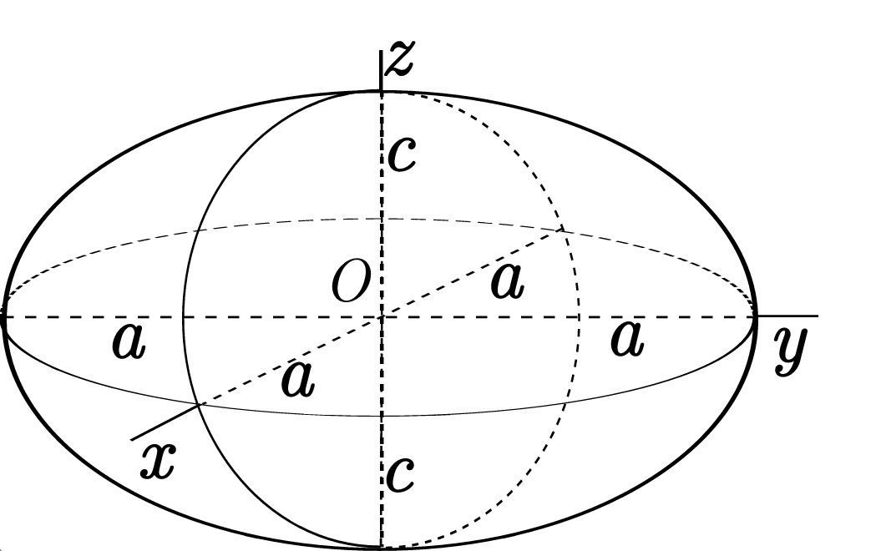
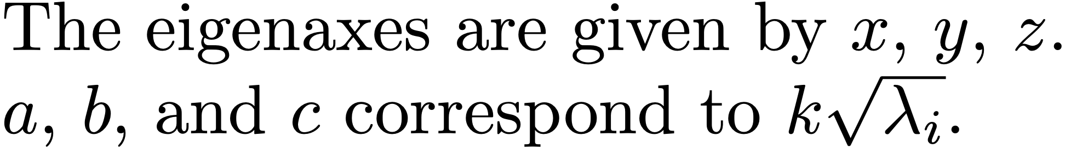
Quadratic Forms
Notes:
Recall that for a positive definite matrix $P=P^{\top}>0$, the set
\[
\mathcal{E}(k) = \left\{y\in\mathbb{R}^n: y^{\top}P^{-1}y=k^2 \right\}
\]
is an ellipsoid whose axes are aligned with the eigenvectors of $P$, with stretching along each axis given by $k\sqrt{\lambda_i}$ where $\lambda_i$ is an eigenvalue of $P$.
--
(From wikipedia)
--
The eigenaxes are given by $x$, $y$, $z$.
$a$, $b$, and $c$ correspond to $k\sqrt{\lambda_i}$.

Slide 24
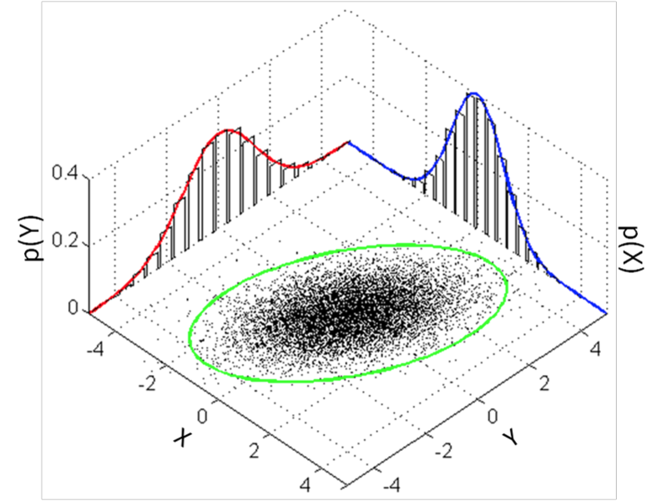
Multivariate Gaussian
Notes:
The multivariate Gaussian distribution is given by
\[
\mathcal{N}(\mu,P) = \frac{1}{(2\pi)^{k/2}\|P\|^{1/2}}\text{exp}\left(-\frac{1}{2}(x-\mu)^{\top}P^{-1}(x-\mu)\right),
\]
where $\mu$ is the mean and $P$ is the covariance matrix. The $k^{th}-\sigma$ ellipsoid is defined as
\[
\mathcal{E}(k) = \left\{x\in\mathbb{R}^k: (x-\mu)^{\top}P^{-1}(x-\mu) = k^2 \right\}
\]
where $one-\sigma$ or $k=1$ corresponds the the ellipsoid that represents one standard deviation from the mean $\mu$.

Slide 25
Kalman Filter
Notes:
Assume continuous linear system dynamics, with discrete measurement update
\begin{align*}
\dot{x} &= Ax + Bu + \xi \\
y[n] &= Cx[n] + \eta[n],
\end{align*}
where
$\xi\sim\mathcal{N}(0,Q)$ is the process noise,
$\nu\sim\mathcal{N}(0,R)$ is the measurement noise.
The measurement covariance $R$ is usually obtained from sensor calibration. The process covariance $Q$ represents all other uncertainties in the system and is the tuning parameter for the Kalman filter.

Slide 26
Kalman Filter Derivation
Notes:
The continuous-discrete Kalman filter has the form
\begin{align*}
\dot{\hat{x}} &= A\hat{x} + Bu \qquad \qquad \qquad \qquad \text{(Prediction)} \\
\hat{x}^+ &= \hat{x}^- + L(y(t_n) - C\hat{x}^-). \qquad \text{(Correction)}
\end{align*}
%
Define the estimation error
\[
\tilde{x} = x-\hat{x},
\]
and the covariance of the estimation error
\[
P(t) = E\{ \tilde{x}(t) \tilde{x}(t)^{\top} \},
\]
where $P=P^\top \geq 0$.
\vspace{0.5cm}
\par\noindent{\bf Estimation Objective:} Chose the estimation gain $L$ s.t.
\begin{itemize}
\item $E\{\tilde{x}(t)\}=0$ (unbiased),
\item $\text{trace}(P) = \sum \lambda_i$ is minimized.
\end{itemize}

Slide 27
Kalman Filter Derivation
Notes:
\par\noindent{\bf Between Measurements (prediction):}
Differentiate $\tilde{x}$
\begin{align*}
\dot{\tilde{x}} &= \dot{x} - \dot{\hat{x}} \\
&= Ax + Bu + \xi - A\hat{x} - Bu \\
&= A\tilde{x} + \xi.
\end{align*}
Solve for $\tilde{x}(t)$:
\[
\tilde{x}(t) = e^{At}\tilde{x}_0 + \int_0^t
e^{A(t-\tau)}\xi(\tau)\,d\tau.
\]
Note that
\[
E\left\{\tilde{x}(t)\right\} = e^{At}E\left\{\tilde{x}_0\right\} + \int_0^t
e^{A(t-\tau)}E\left\{\xi(\tau)\right\}\,d\tau = 0
\]

Slide 28
Kalman Filter Derivation
Notes:
\par\noindent{\bf Between Measurements (prediction):}
Compute the evolution of the error covariance $P$:
\begin{align*}
\dot{P} &= \frac{d}{dt} E\{\tilde{x}\tilde{x}^{\top}\}
= E\{ \dot{\tilde{x}}\tilde{x}^{\top} + \tilde{x}\dot{\tilde{x}}^{\top} \} \\
&= E\left\{ A\tilde{x}\tilde{x}^{\top} + \xi\tilde{x}^{\top} +
\tilde{x}\tilde{x}^{\top}A^{\top} + \tilde{x}\xi^{\top} \right\} \\
&= AP + PA^{\top} + E\{\xi\tilde{x}^{\top}\} + E\{\tilde{x}\xi^{\top}\},
\end{align*}
Where
\begin{align*}
E\{\tilde{x}\xi^{\top}\} &=
E\{
e^{At}\tilde{x}_0 \xi^{\top}(t)
+ \int_0^t e^{A(t-\tau)}\xi(\tau)\xi^{\top}(t)\,d\tau
\} \\
&= \int_0^t e^{A(t-\tau)}Q\delta(t-\tau)\,d\tau \\
&= \frac{1}{2} Q. \qquad \text{(only used half of area in delta function)}
\end{align*}
Therefore
\[
\dot{P} = AP + PA^{\top} + Q.
\]

Slide 29
Kalman Filter Derivation
Notes:
\par\noindent{\bf At Measurements (correction):}
At a measurement, we have that
\begin{align*}
\tilde{x}^{+} &= x-\hat{x}^{+} \\
&= x-\hat{x}^{-} - L\left(Cx + \eta - C\hat{x}^{-}\right) \\
&= \tilde{x}^{-} - LC\tilde{x}^{-} - L\eta.
\end{align*}
We also have that
\begin{align*}
P^{+} &= E\{ \tilde{x}^{+}\tilde{x}^{+T} \} \\
&= E\left\{ \left( \tilde{x}^{-} - LC\tilde{x}^{-} - L\eta \right)
\left( \tilde{x}^{-} - LC\tilde{x}^{-} - L\eta \right)^{\top} \right\} \notag \\
&= E\Big\{ \tilde{x}^{-}\tilde{x}^{-\top} -
\tilde{x}^{-}\tilde{x}^{-\top} C^{\top} L^{\top} - \tilde{x}^{-} \eta^{\top} L^{\top}
-LC\tilde{x}^{-}\tilde{x}^{-\top} + LC
\tilde{x}^{-}\tilde{x}^{-\top} C^{\top} L^{\top} + LC\tilde{x}^{-}\eta^{\top}L^{\top}
\\ & \qquad \qquad
-L\eta\tilde{x}^{-\top} + L\eta\tilde{x}^{-\top}C^{\top}L^{\top} +
L\eta\eta^{\top}L^{\top} \Big\} \\
&= P^{-} - P^{-}C^{\top}L^{\top} - LCP^{-} + LCP^{-}C^{\top}L^{\top} + LRL^{\top} \\
&= (I - LC)P^{-}(I-LC)^\top + LRL^\top.
\end{align*}
\par\noindent{\bf Objective:} Pick $L$ to minimize $\text{trace}(P^+)$.

Slide 30
Kalman Filter Derivation
Notes:
\par\noindent{\bf At Measurements (correction):}
Using
\begin{align*}
\frac{\partial}{\partial A} \text{trace}(BAD) &= B^{\top} D^{\top},
\\
\frac{\partial}{\partial A} \text{trace}(ABA^{\top}) &= 2AB, \text{~if~} B=B^{\top},
\\
\frac{\partial}{\partial A} \text{trace}(AB) &= B
\end{align*}
a necessary condition is
\begin{align*}
\frac{\partial}{\partial L} \text{tr}(P^{+})
&= \frac{\partial}{\partial L}\text{tr}\Big((I - LC)P^{-}(I-LC)^\top + LRL^\top\Big)
= -P^{-}C^{\top} - P^{-}C^{\top}
+ 2LCP^{-}C^{\top} + 2LR = 0 \\
\implies & 2L^\ast (R+CP^{-}C^{\top})=2P^{-}C^{\top} \\
\implies & L^\ast = P^{-}C^{\top}(R+CP^{-}C^{\top})^{-1}.
\end{align*}
Substituting into prior equation for $P^+$ gives (after algebra)
\[
P^{+} = (I - L^\ast C) P^{-} (I-L^\ast C)^\top + L^\ast R L^{\ast\top}.
\]

Slide 31
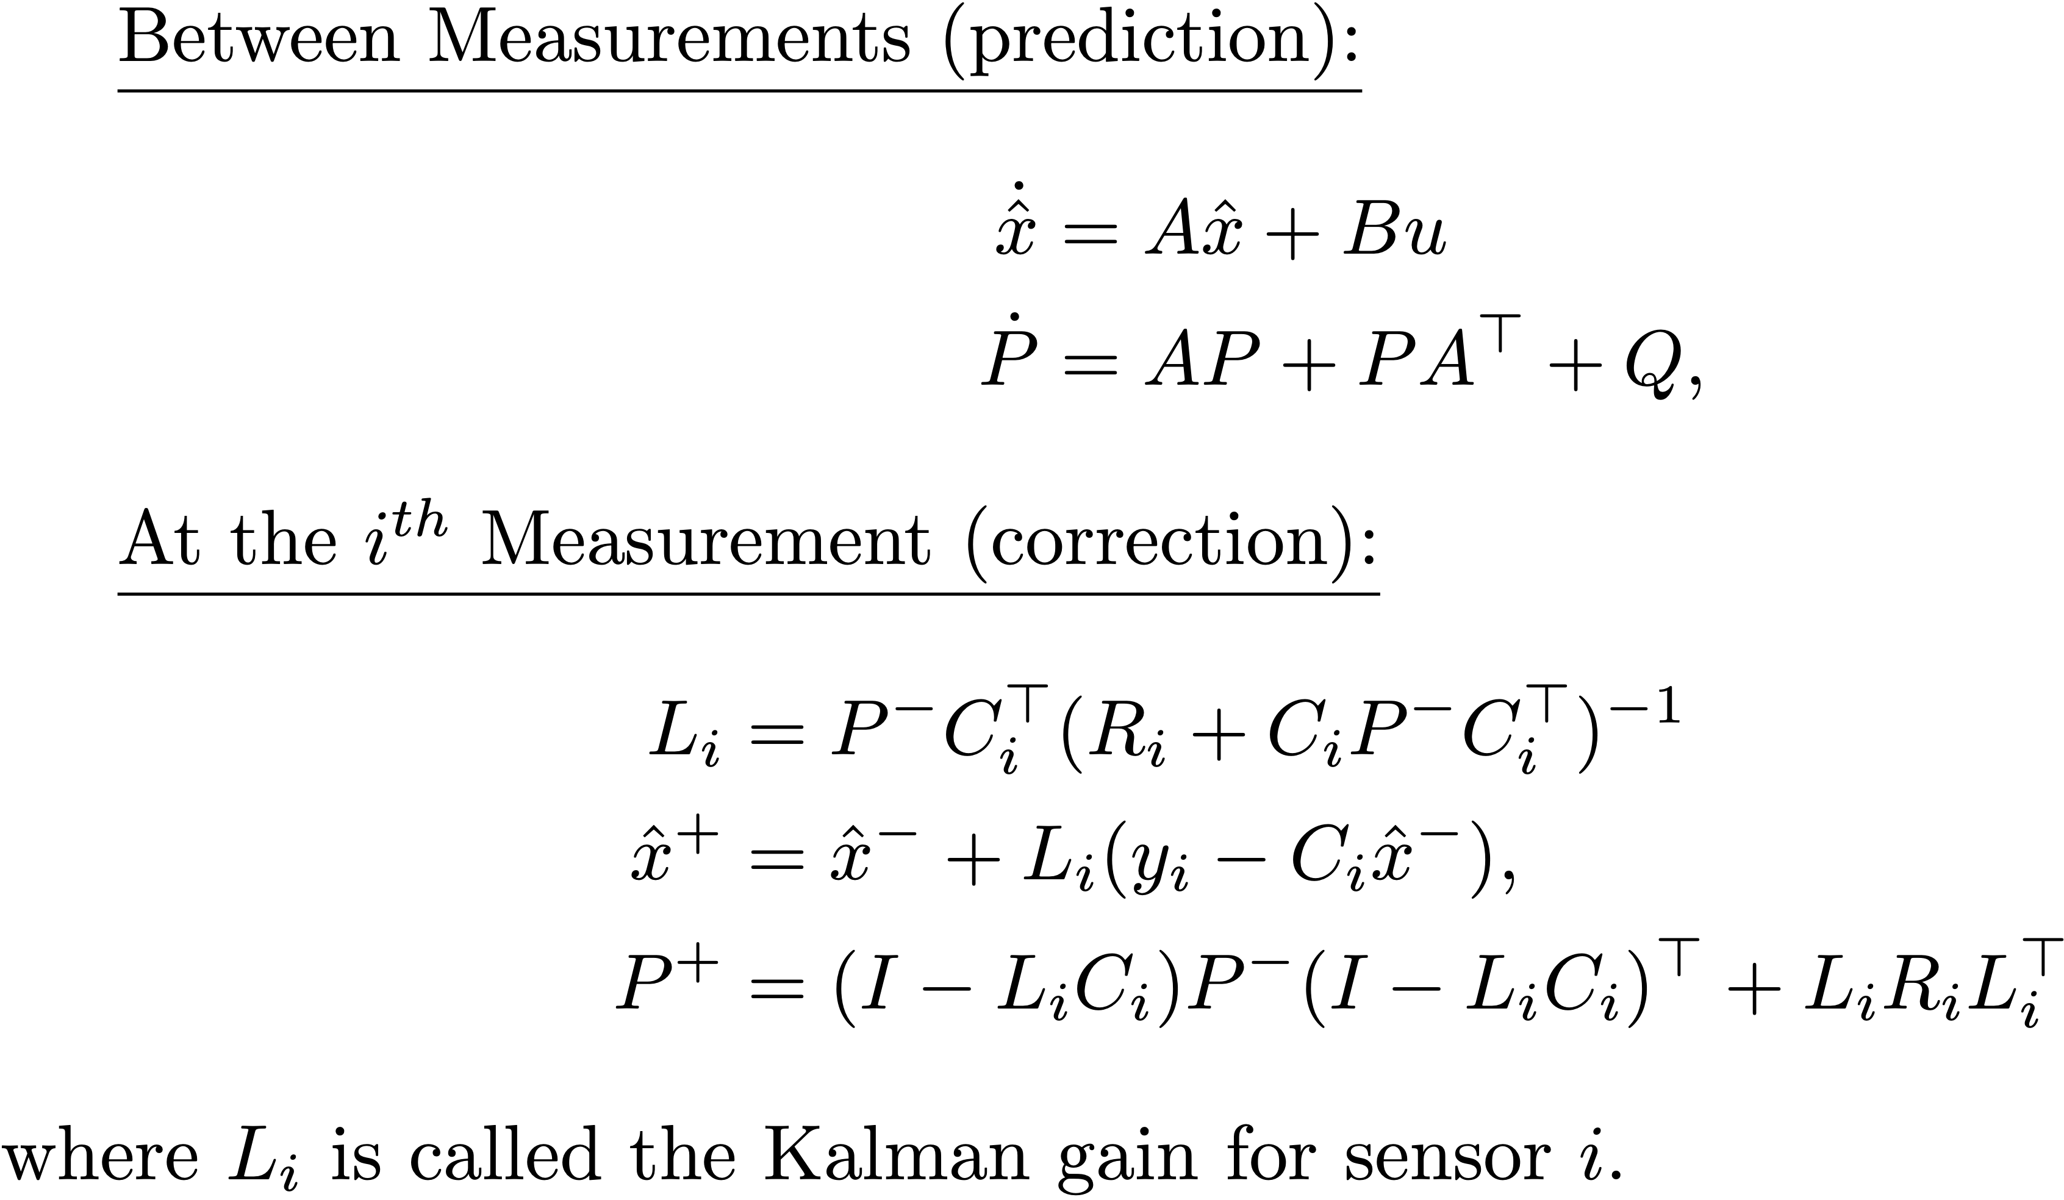
Kalman Filter Derivation
Notes:
\underline{Between Measurements (prediction):}
\begin{align*}
\dot{\hat{x}} &= A\hat{x} + Bu \\
\dot{P} &= AP + PA^{\top} + Q,
\end{align*}
\underline{At the $i^{th}$ Measurement (correction):}
\begin{align*}
L_i &= P^{-}C_i^{\top}(R_i+C_iP^{-}C_i^{\top})^{-1} \\
\hat{x}^+ &= \hat{x}^- + L_i(y_i - C_i \hat{x}^-), \\
P^{+} &= (I-L_i C_i) P^{-} (I-L_i C_i)^\top + L_i R_i L_i^{\top}
\end{align*}
where $L_i$ is called the Kalman gain for sensor $i$.

Slide 32
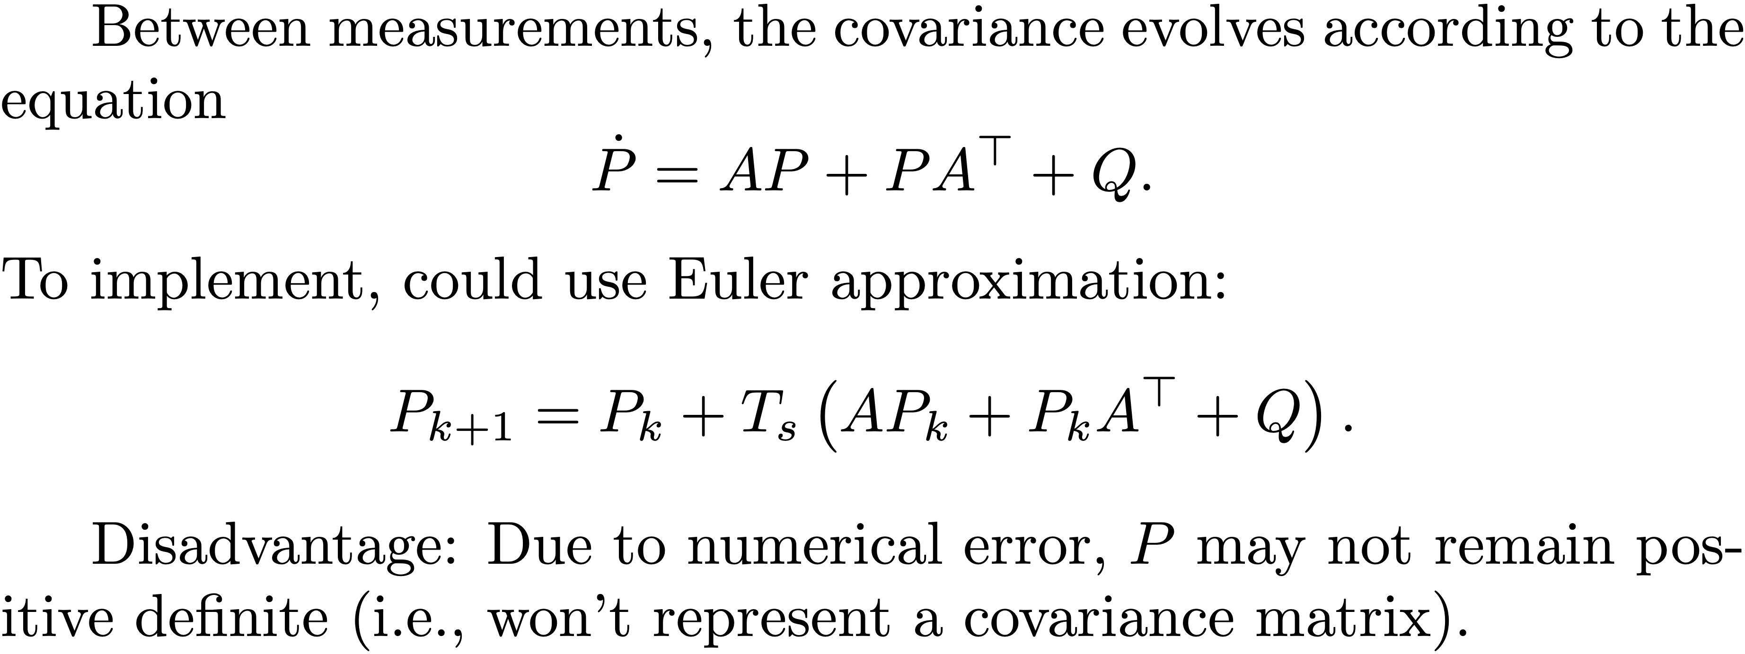
Covariance Update
Notes:
Between measurements, the covariance evolves according to the equation
\[
\dot{P} = AP + PA^\top + Q.
\]
To implement, could use Euler approximation:
\[
P_{k+1} = P_k + T_s \left(AP_k + P_kA^\top + Q\right).
\]
Disadvantage: Due to numerical error, $P$ may not remain positive definite (i.e., won't represent a covariance matrix).

Slide 33
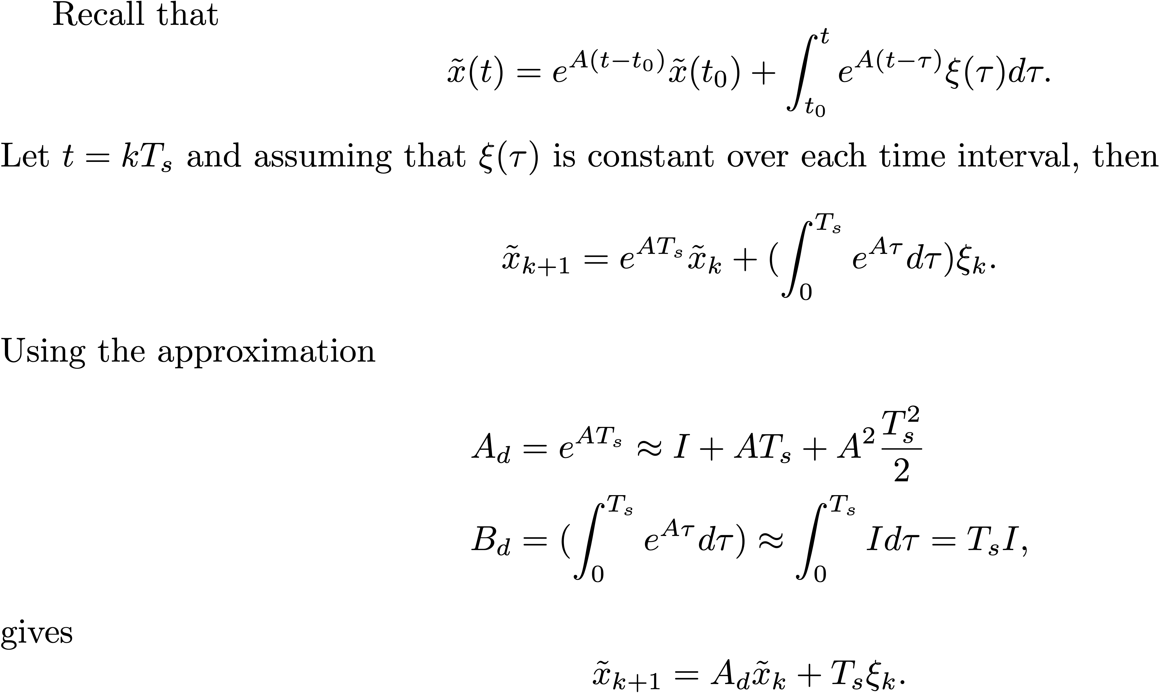
Covariance Update
Notes:
Recall that
\[
\tilde{x}(t) = e^{A(t-t_0)}\tilde{x}(t_0) + \int_{t_0}^t e^{A(t-\tau)} \xi(\tau) d\tau.
\]
Let $t=kT_s$ and assuming that $\xi(\tau)$ is constant over each time interval, then
\[
\tilde{x}_{k+1} = e^{AT_s} \tilde{x}_k + (\int_{0}^{T_s} e^{A\tau} d\tau) \xi_k.
\]
Using the approximation
\begin{align*}
A_d &= e^{AT_s} \approx I + AT_s + A^2 \frac{T_s^2}{2} \\
B_d &= (\int_{0}^{T_s} e^{A\tau} d\tau) \approx \int_0^{T_s} I d\tau = T_s I,
\end{align*}
gives
\[
\tilde{x}_{k+1} = A_d \tilde{x}_k + T_s \xi_k.
\]

Slide 34
Covariance Update
Notes:
Therefore, the covariance update becomes
\begin{align*}
P_{k+1} &= E\{\tilde{x}_{k+1}\tilde{x}_{k+1}^\top\} \\
&= E\{(A_d \tilde{x}_k + T_s \xi_k)(A_d \tilde{x}_k + T_s \xi_k)^\top\} \\
&= E\{A_d \tilde{x}_k \tilde{x}_k^\top A_d + T_s \xi_k\tilde{x}_k^\top A_d^\top
+ A_d \tilde{x}_k + T_s \xi_k \xi_k^\top + T_s^2\xi_k\xi_k^\top\} \\
&= A_d E\{\tilde{x}_k \tilde{x}_k^\top\}\ A_d^\top + T_s E\{\xi_k\tilde{x}_k^\top\} A_d^\top
+ T_s A_d E\{\tilde{x}_k\xi_k^\top\} + T_s^2 E\{\xi_k\xi_k^\top\} \\
&= A_d P_k A_d^\top + T_s^2 Q.
\end{align*}
Note that the last line ensures that the error covariance remains positive definite since the sum of positive definite matrices is positive definite.

Slide 35
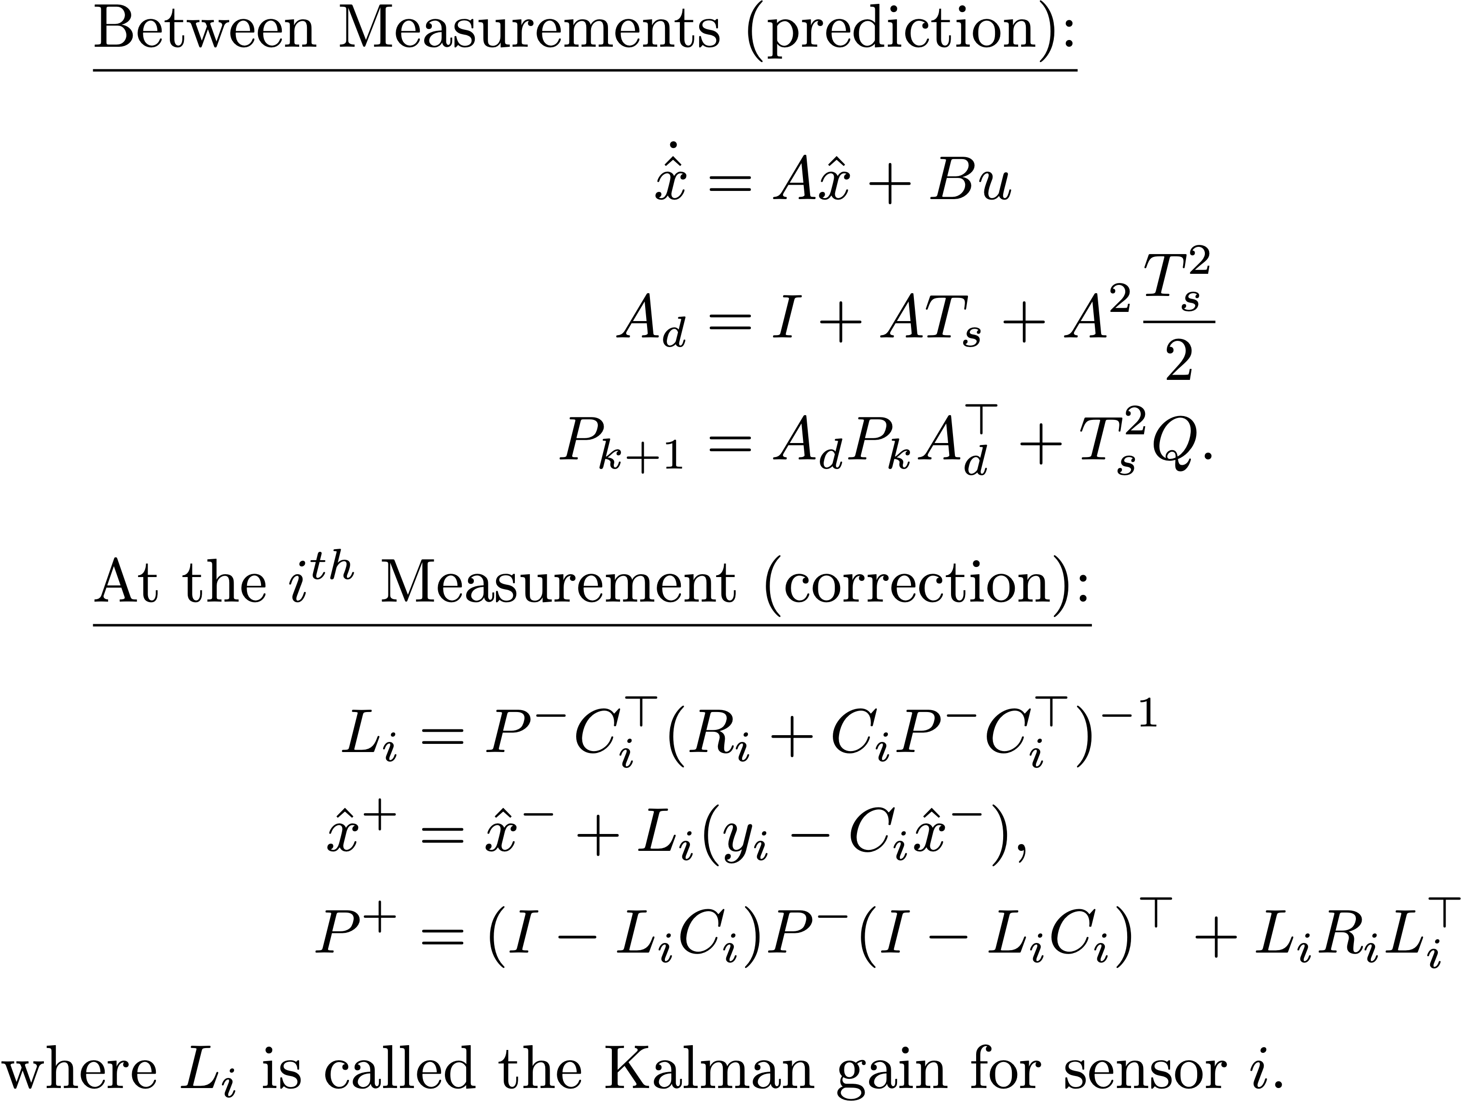
Kalman Filter Derivation
Notes:
\underline{Between Measurements (prediction):}
\begin{align*}
\dot{\hat{x}} &= A\hat{x} + Bu \\
A_d &= I + AT_s + A^2 \frac{T_s^2}{2} \\
P_{k+1} &= A_d P_k A_d^\top + T_s^2 Q.
\end{align*}
\underline{At the $i^{th}$ Measurement (correction):}
\begin{align*}
L_i &= P^{-}C_i^{\top}(R_i+C_iP^{-}C_i^{\top})^{-1} \\
\hat{x}^+ &= \hat{x}^- + L_i(y_i - C_i \hat{x}^-), \\
P^{+} &= (I-L_i C_i) P^{-} (I-L_i C_i)^\top + L_i R_i L_i^{\top}
\end{align*}
where $L_i$ is called the Kalman gain for sensor $i$.

Slide 36
Extended Kalman Filter
Notes:
Basic idea of Extended Kalman Filter:
\begin{itemize}
\item Propagate multivariate Gaussian distribution that captures probability distribution associated with belief about state
\item Mean of distribution is $\hat{x}$ --- estimated state
\item Covariance quantifies associated estimation error
\item Kalman gain minimizes covariance of estimation error given uncertainty in model and measurements
\end{itemize}
\vspace{0.25in} \noindent
System model given by:
\begin{align*}
\dot{x} &= f(x,u) + \xi \\
y_i[n] &= h_i(x[n],u[n]) + \eta_i[n],
\end{align*}
where
\begin{align*}
\xi &\sim \mathcal{N}(0,Q) \\
\eta_i &\sim \mathcal{N}(0,R_i) \\
\end{align*}

Slide 37
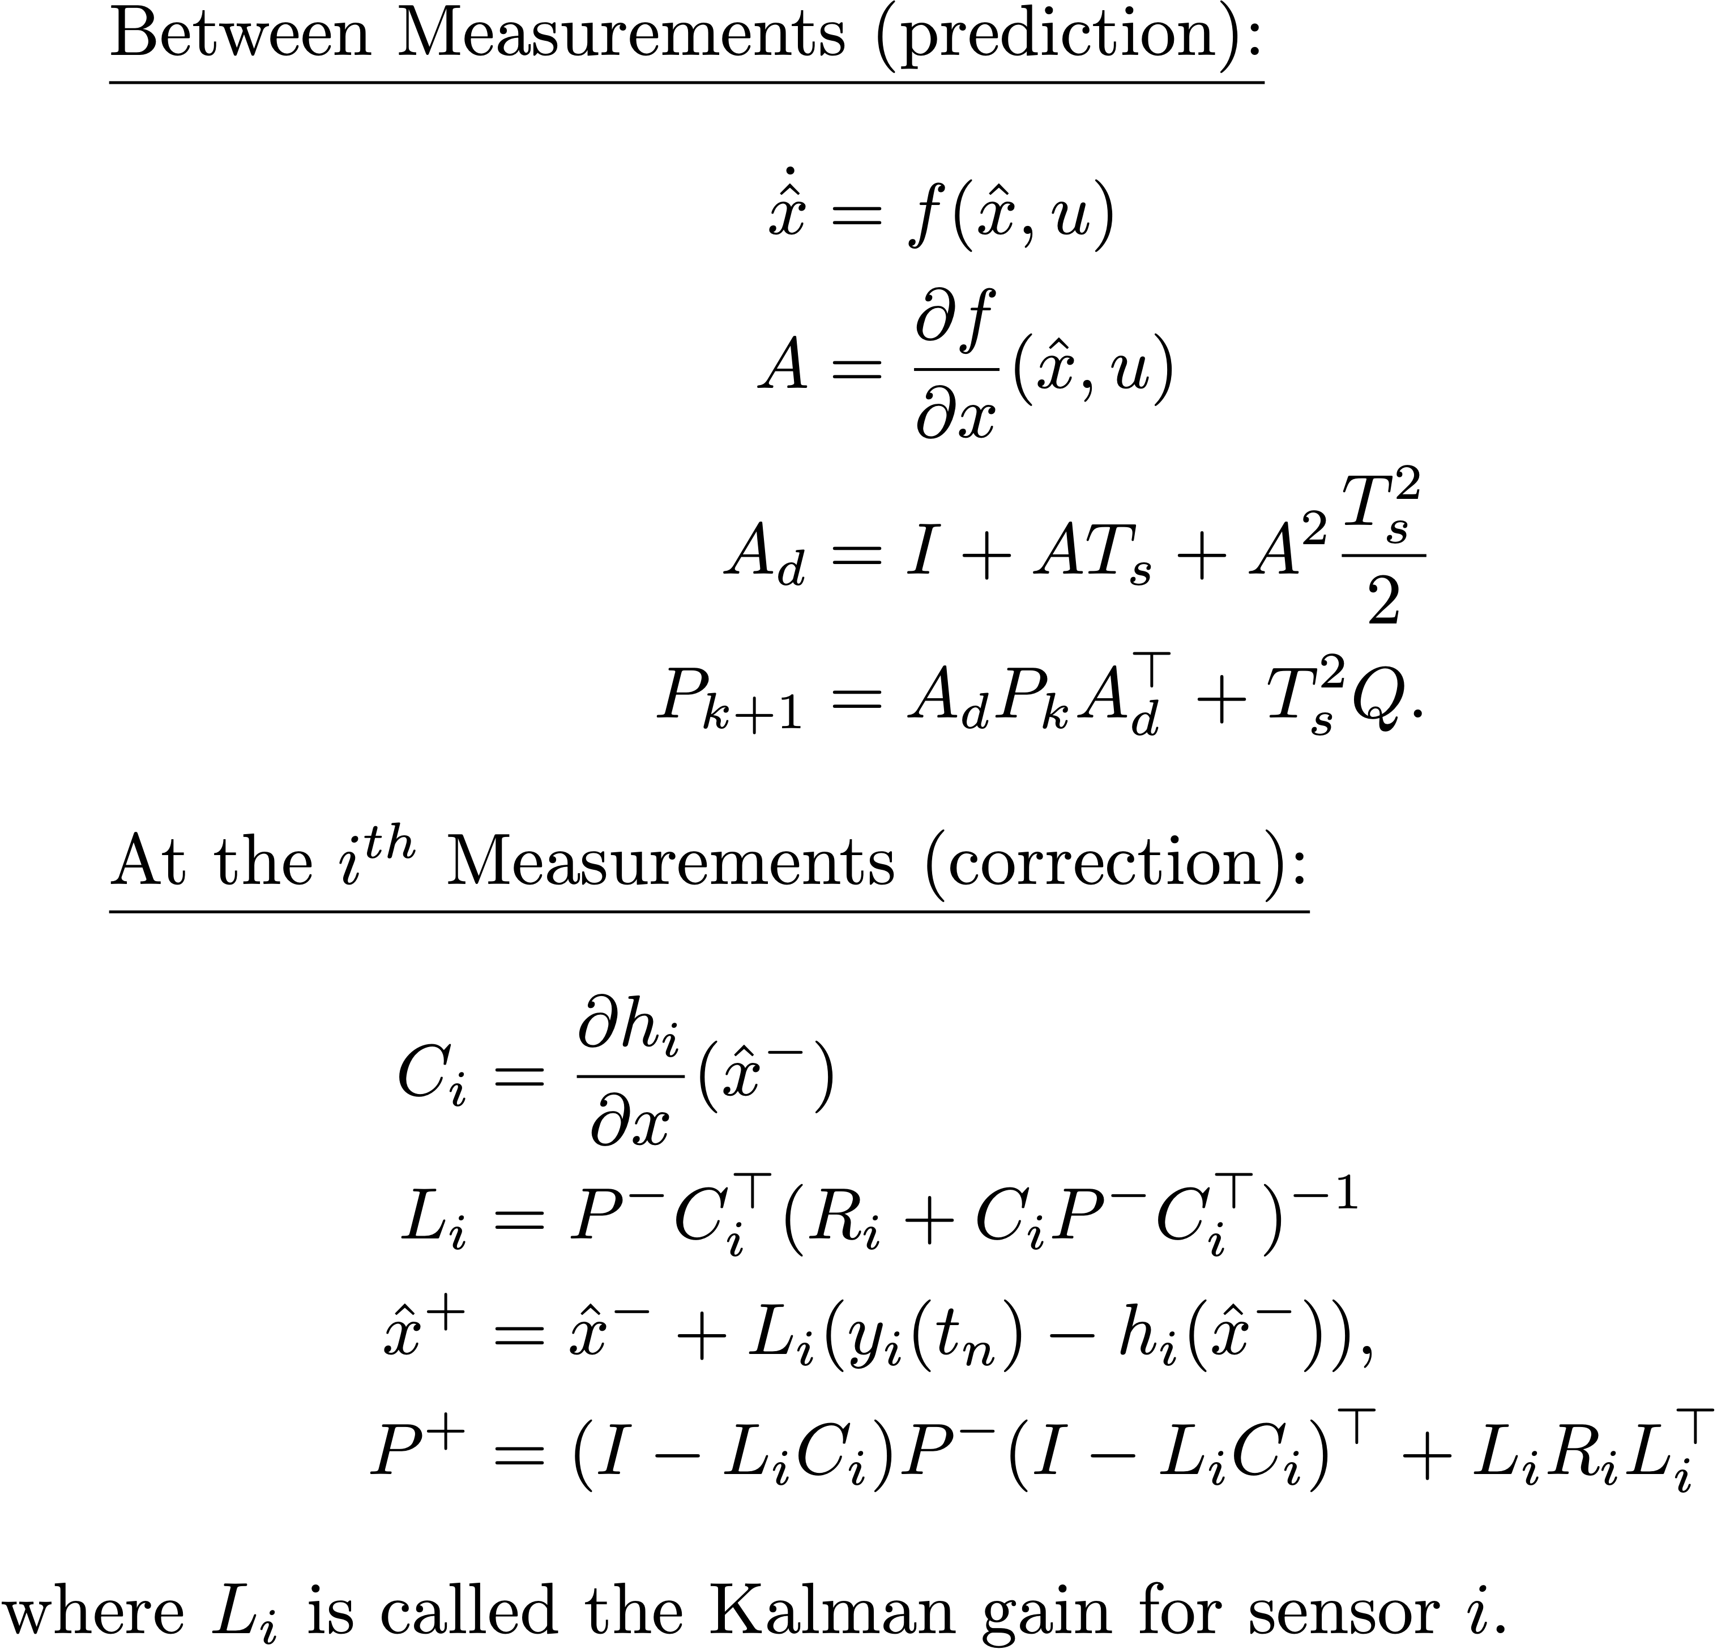
Extended Kalman Filter, cont.
Notes:
\underline{Between Measurements (prediction):}
\begin{align*}
\dot{\hat{x}} &= f(\hat{x}, u) \\
A &= \frac{\partial f}{\partial x}(\hat{x},u) \\
\dot{P} &= AP + PA^{\top} + Q,
\end{align*}
\underline{At the $i^{th}$ Measurements (correction):}
\begin{align*}
C_i &= \frac{\partial h_i}{\partial x}(\hat{x}^-) \\
L_i &= P^{-}C_i^{\top}(R_i+C_iP^{-}C_i^{\top})^{-1} \\
\hat{x}^+ &= \hat{x}^- + L_i(y_i(t_n) - h_i(\hat{x}^-)), \\
P^{+} &= (I-L_i C_i) P^{-} (I-L_i C_i)^\top + L_i R_i L_i^{\top}
\end{align*}
where $L_i$ is called the Kalman gain for sensor $i$.

Slide 38
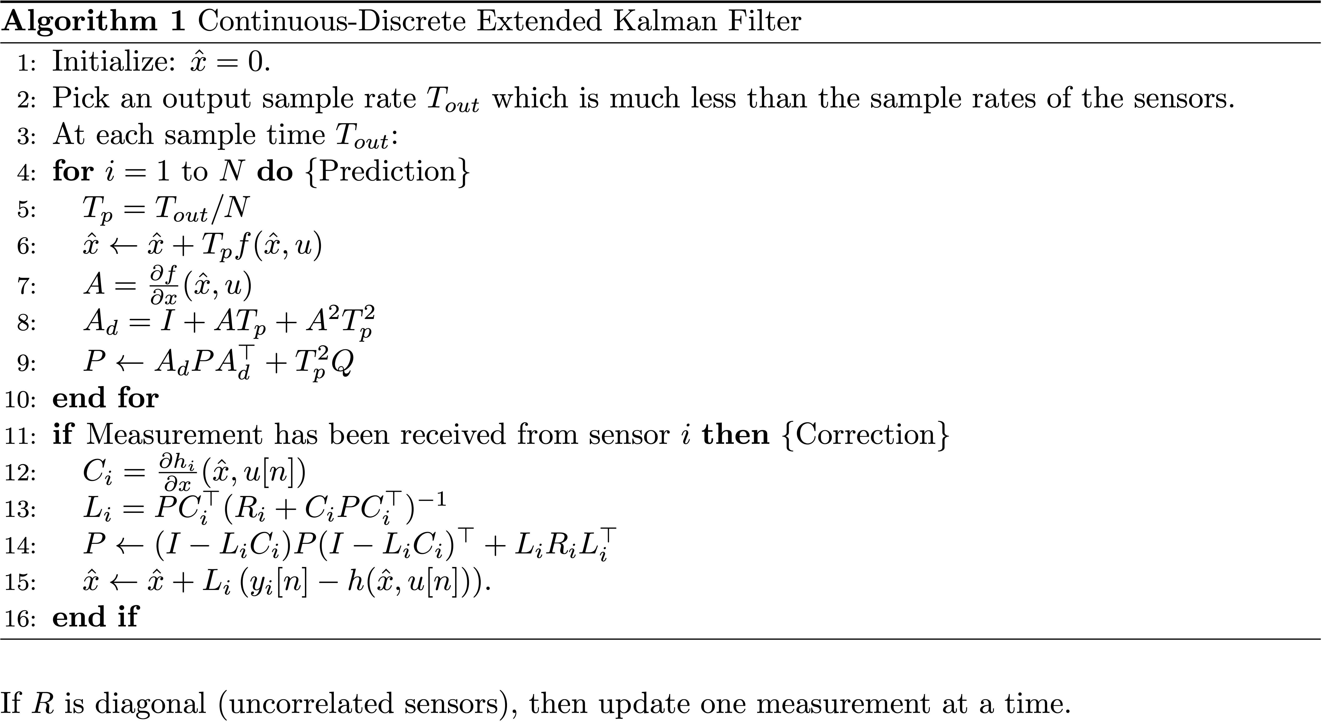
EKF Algorithm
Notes:
\begin{algorithm}
\caption{Continuous-Discrete Extended Kalman Filter}
\label{alg:est-kalman-continuous-discrete}
\begin{algorithmic}[1]
\STATE Initialize: $\hat{x} = 0$.
\STATE Pick an output sample rate $T_{out}$ which is much less than
the sample rates of the sensors.
\STATE At each sample time $T_{out}$:
\FOR[Prediction]{$i=1$ to $N$}
\STATE $T_p = T_{out}/N$
\STATE $\hat{x} \leftarrow \hat{x} + T_p f(\hat{x},u)$
\STATE $A = \frac{\partial f}{\partial x}(\hat{x},u)$
\STATE $A_d = I + A T_p + A^2 T_p^2$
\STATE $P \leftarrow A_d P A_d^\top + T_p^2 Q$
\ENDFOR
\IF[Correction]{Measurement has been received from
sensor $i$}
\STATE $C_i = \frac{\partial h_i}{\partial x}(\hat{x},u[n])$
\STATE $L_i = PC_i^{\top}(R_i+C_iPC_i^{\top})^{-1}$
\STATE $P \leftarrow (I-L_i C_i) P (I-L_i C_i)^\top + L_i R_i L_i^{\top}$
\STATE $\hat{x} \leftarrow \hat{x} + L_i\left( y_i[n] - h(\hat{x},u[n]) \right)$.
\ENDIF
\end{algorithmic}
\end{algorithm}
\noindent If $R$ is diagonal (uncorrelated sensors), then update one measurement at a time.

Slide 39
Attitude Estimation Using EKF
Notes:
\noindent
Use the nonlinear propagation model
\begin{align*}
\dot{\phi} &= p + q\sin\phi\tan\theta + r\cos\phi\tan\theta +
\xi_{\phi} \\
\dot{\theta} &= q\cos\phi - r\sin\phi +\xi_{\theta}
\end{align*}
where
\[
\xi_{\phi}\sim\mathcal{N}(0,Q_{\phi}) \qquad \text{~and~} \qquad
\xi_{\theta}\sim\mathcal{N}(0,Q_{\theta})
\]
Use accelerometers as measured outputs:
\begin{equation*}
y_{\text{accel}} =
\begin{pmatrix}
\dot{u} + qw - rv + g\sin\theta \\
\dot{v}+ru-pw - g\cos\theta\sin\phi \\
\dot{w}+pv-qu - g\cos\theta\cos\phi
\end{pmatrix}
+ \eta_{\text{accel}}.
\end{equation*}
\vspace{.5cm}
\noindent
Problem: Do not have method for directly measuring $\dot{u}$,
$\dot{v}$, $\dot{w}$, $u$, $v$, and $w$.
\vspace{.5cm}
\noindent
What do we do?

Slide 40
Attitude Estimation Using EKF
Notes:
\noindent Assume that $\dot{u}=\dot{v}=\dot{w}\approx 0$
\noindent Recall that
\[
\begin{pmatrix} u \\ v \\ w \end{pmatrix} \approx V_a
\begin{pmatrix} \cos\alpha\cos\beta \\ \sin\beta \\
\sin\alpha\cos\beta \end{pmatrix}.
\]
Assuming that $\alpha\approx\theta$ and $\beta\approx 0$ gives
\[
\begin{pmatrix} u \\ v \\ w \end{pmatrix} \approx V_a
\begin{pmatrix} \cos\theta \\ 0 \\
\sin\theta \end{pmatrix}
\]
Substituting into original output equation
\begin{equation*}
y_{\text{accel}} =
\begin{pmatrix}
\dot{u} + qw - rv + g\sin\theta \\
\dot{v}+ru-pw - g\cos\theta\sin\phi \\
\dot{w}+pv-qu - g\cos\theta\cos\phi
\end{pmatrix}
+ \eta_{\text{accel}}
\end{equation*}
gives
\[
y_{\text{accel}} =
\begin{pmatrix}
qV_a\sin\theta + g\sin\theta \\
rV_a\cos\theta - pV_a\sin\theta - g\cos\theta\sin\phi \\
-qV_a\cos\theta - g\cos\theta\cos\phi
\end{pmatrix}
+ \eta_{\text{accel}}
\]

Slide 41
Attitude Estimation Using EKF
Notes:
\noindent
Defining $x = (\phi, \theta)^{\top}$, $u=(p,q,r,V_a)^{\top}$, $\xi =
(\xi_{\phi}, \xi_{\theta})^{\top}$, and $\eta = (\eta_{\phi},
\eta_{\theta})^{\top}$, gives
\begin{align*}
\dot{x} &= f(x,u) + \xi \\
y &= h(x,u) + \eta,
\end{align*}
where
\begin{align*}
f(x,u) &= \begin{pmatrix}
p + q\sin\phi\tan\theta + r\cos\phi\tan\theta\\
q\cos\phi - r\sin\phi
\end{pmatrix} \\
h(x,u) &=
\begin{pmatrix}
qV_a\sin\theta + g\sin\theta \\
rV_a\cos\theta - pV_a\sin\theta - g\cos\theta\sin\phi \\
-qV_a\cos\theta - g\cos\theta\cos\phi
\end{pmatrix}
\end{align*}

Slide 42
Attitude Estimation Using EKF
Notes:
\noindent
Implementation of Kalman filter requires Jacobians
$\pde{f}{x}$ and $\pde{h}{x}$. \\ Accordingly,
\begin{align*}
\pde{f}{x} &=
\begin{pmatrix}
q\cos\phi\tan\theta - r\sin\phi\tan\theta &
\frac{q\sin\phi-r\cos\phi}{\cos^2\theta} \\
-q\sin\phi - r\cos\phi &
0
\end{pmatrix} \\
\pde{h}{x} &=
\begin{pmatrix}
0 &
qV_a\cos\theta + g\cos\theta \\
-g\cos\phi\cos\theta &
-rV_a\sin\theta -
pV_a\cos\theta + g\sin\phi\sin\theta \\
g\sin\phi\cos\theta &
\left(qV_a + g\cos\phi\right)\sin\theta
\end{pmatrix}.
\end{align*}
\vspace{.5cm}
\noindent
At this point, we have everything we need to implement the continuous-discrete EKF.
\vspace{.5cm}
\noindent
How well does it work?

Slide 43
Attitude Estimation Results
Not perfect, but significantly better!

Slide 44
GPS Smoothing
Notes:
\begin{itemize}
\item Want to fill in estimates between GPS measurements
\item Want to estimate wind
\end{itemize}
\noindent
Assuming level flight, evolution of position:
\begin{align*}
\dot{p}_n &= V_g\cos\chi \\
\dot{p}_e &= V_g\sin\chi
\end{align*}
\noindent
Evolution of the ground speed:
\begin{align*}
\dot{V}_g &= \frac{d}{dt} \sqrt{(V_a\cos\psi+w_n)^2 + (V_a\sin\psi+w_e)^2} \\
&= \frac{(V_a\cos\psi+w_n)(\dot{V}_a\cos\psi-V_a\dot{\psi}\sin\psi+\dot{w}_n)+(V_a\sin\psi+w_e)(\dot{V}_a\sin\psi+V_a\dot{\psi}\cos\psi+\dot{w}_e)}{V_g}
\end{align*}
Assuming that wind and airspeed are constant:
\[
\dot{V}_g = \frac{(V_a\cos\psi+w_n)(-V_a\dot{\psi}\sin\psi)+(V_a\sin\psi+w_e)(V_a\dot{\psi}\cos\psi)}{V_g}
\]

Slide 45
GPS Smoothing

Slide 46
GPS Smoothing
Notes:
\noindent
Evolution of $\chi$:
\[
\dot{\chi}=\frac{g}{V_g}\tan\phi\cos(\chi-\psi)
\]
\noindent
Assuming that wind is constant:
\begin{align*}
\dot{w}_n &= 0 \\
\dot{w}_e &= 0
\end{align*}
\noindent
From kinematics, evolution of $\psi$:
\begin{equation*}
\dot{\psi} = q\frac{\sin\phi}{\cos\theta} + r\frac{\cos\phi}{\cos\theta}
\end{equation*}

Slide 47
GPS Smoothing
Notes:
\noindent
Define: \\
$x=(p_n,p_e,V_g,\chi,w_n,w_e,\psi)^{\top}$ \\
$u=(V_a, q, r, \phi, \theta)^{\top}$ \\
\\
Jacobian of $f$:
\[
\pde{f}{x} =
\begin{pmatrix}
0 & 0 & \cos\chi & -V_g\sin\chi & 0 & 0 & 0 \\
0 & 0 & \sin\chi & V_g\cos\chi & 0 & 0 & 0 \\
0 & 0 & -\frac{\dot{V}_g}{V_g} & 0 & -\dot{\psi}V_a\sin\psi & \dot{\psi}V_a\cos\psi & \frac{\partial \dot{V}_g}{\partial \psi} \\
0 & 0 & \frac{\partial \dot{\chi}}{\partial V_g} & \frac{\partial \dot{\chi}}{\partial \chi} & 0 & 0 & \frac{\partial \dot{\chi}}{\partial \psi} \\
0 & 0 & 0 & 0 & 0 & 0 & 0 \\
0 & 0 & 0 & 0 & 0 & 0 & 0 \\
0 & 0 & 0 & 0 & 0 & 0 & 0
\end{pmatrix}
\]
where
\begin{align*}
\frac{\partial \dot{V}_g}{\partial \psi} &= \frac{-\dot{\psi}V_a(w_n\cos\psi+w_e\sin\psi)}{V_g} \\
\frac{\partial \dot{\chi}}{\partial V_g} &= -\frac{g}{V_g^2}\tan\phi\cos(\chi-\psi) \\
\frac{\partial \dot{\chi}}{\partial \chi} &= -\frac{g}{V_g}\tan\phi\sin(\chi-\psi) \\
\frac{\partial \dot{\chi}}{\partial \psi} &= \frac{g}{V_g}\tan\phi\sin(\chi-\psi) \\
\end{align*}

Slide 48
GPS Smoothing
Notes:
\noindent
Define: \\
$x=(p_n,p_e,V_g,\chi,w_n,w_e,\psi)^{\top}$ \\
$u=(V_a, q, r, \phi, \theta)^{\top}$ \\
\\
For measurements, use GPS signals for north and east position $(p_n,p_e)$, ground speed $(V_g)$, and course $(\chi)$
\vspace{.5cm}
\noindent
Notice that states are not independent -- related by wind triangle
\vspace{.5cm}
\noindent
Use wind triangle relations to introduce two pseudo measurements. \\
\\
Assume $\gamma=\gamma_a=0$:
\begin{align*}
V_a\cos\psi + w_n &= V_g\cos\chi \\
V_a\sin\psi + w_e &= V_g\sin\chi
\end{align*}
\noindent
From these expressions, define the pseudo measurements
\begin{align*}
y_{\text{windtri,n}} &= V_a\cos\psi + w_n - V_g\cos\chi \\
y_{\text{windtri,e}} &= V_a\sin\psi + w_e - V_g\sin\chi
\end{align*}
where (pseudo) measurement values are equal to zero.

Slide 49
GPS Smoothing
Notes:
\noindent
The resulting measurement model is given by
\[
y_{GPS} = h(x,u) + \eta_{GPS}
\]
where $y_{GPS} = (y_{GPS,n}, y_{GPS,e}, y_{GPS,V_g}, y_{GPS,\chi}, y_{\text{wind,n}}, y_{\text{wind,e}})$, and
\[
h(x,u) = \begin{pmatrix}
p_n \\
p_e \\
V_g \\
\chi \\
V_a\cos\psi + w_n - V_g\cos\chi \\
V_a\sin\psi + w_e - V_g\sin\chi
\end{pmatrix}
\]
and where the Jacobian is given by
\[
\pde{h}{x}(\hat{x},u) =
\begin{pmatrix}
1 & 0 & 0 & 0 & 0 & 0 & 0 \\
0 & 1 & 0 & 0 & 0 & 0 & 0 \\
0 & 0 & 1 & 0 & 0 & 0 & 0 \\
0 & 0 & 0 & 1 & 0 & 0 & 0 \\
0 & 0 & -\cos\chi & V_g\sin\chi & 1 & 0 & -V_a\sin\psi \\
0 & 0 & -\sin\chi & -V_g\cos\chi & 0 & 1 & V_a\cos\psi
\end{pmatrix}
\]

Slide 50
GPS Smoothing Results

Slide 51
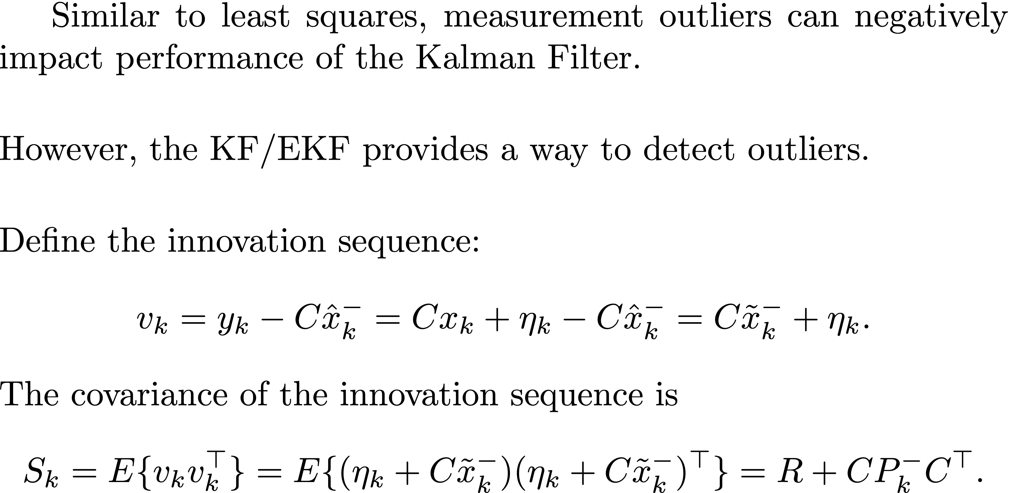
Measurement Gating
Notes:
Similar to least squares, measurement outliers can negatively impact performance of the Kalman Filter.
\vspace{0.5cm}
\noindent However, the KF/EKF provides a way to detect outliers.
\vspace{0.5cm}
\noindent Define the innovation sequence:
\begin{align*}
v_k = y_k - C \hat{x}_k^- = C x_k + \eta_k - C\hat{x}_k^- = C\tilde{x}_k^- + \eta_k.
\end{align*}
The covariance of the innovation sequence is
\begin{align*}
S_k &= E\{ v_k v_k^\top \} = E\{ (\eta_k + C\tilde{x}_k^-)(\eta_k + C\tilde{x}_k^-)^\top \} = R + C P_k^- C^\top.
\end{align*}

Slide 52
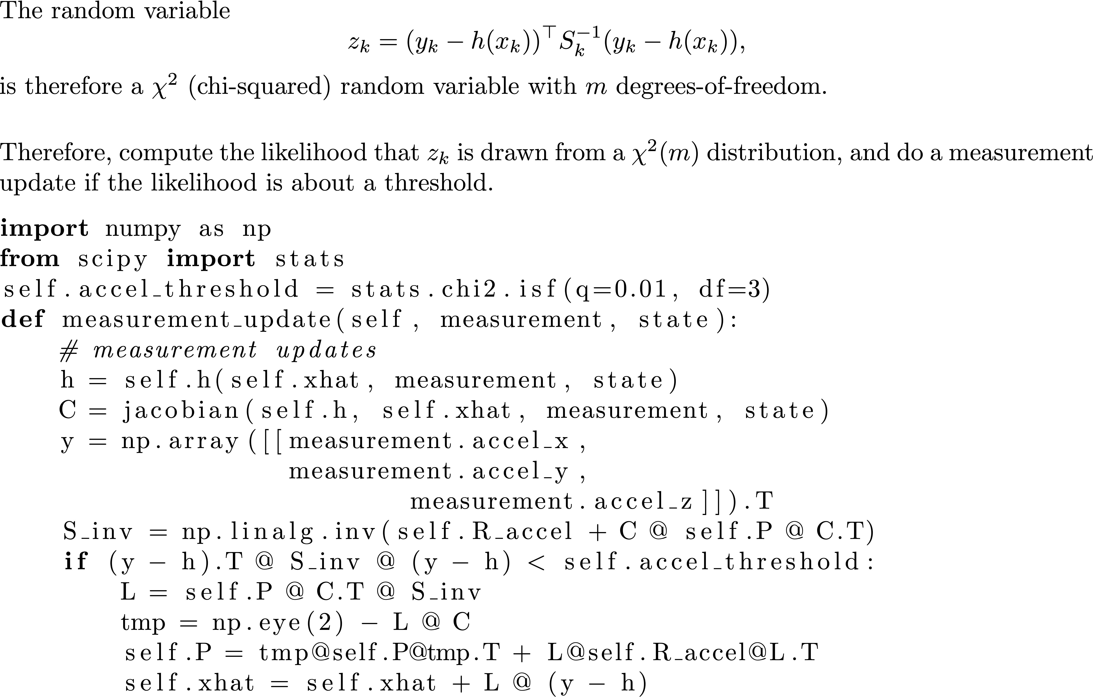
Measurement Gating
Notes:
Similar to least squares, measurement outliers can negatively impact performance of the Kalman Filter.
\vspace{0.5cm}
\noindent However, the KF/EKF provides a way to detect outliers.
\vspace{0.5cm}
\noindent Define the innovation sequence:
\begin{align*}
v_k = y_k - C \hat{x}_k^- = C x_k + \eta_k - C\hat{x}_k^- = C\tilde{x}_k^- + \eta_k.
\end{align*}
The covariance of the innovation sequence is
\begin{align*}
S_k &= E\{ v_k v_k^\top \} = E\{ (\eta_k + C\tilde{x}_k^-)(\eta_k + C\tilde{x}_k^-)^\top \} = R + C P_k^- C^\top.
\end{align*}

Slide 53
Suggestions for Tuning Your EKF
Implement EKF in steps
Attitude estimation
GPS smoother
Test and tune each component independently and thoroughly
Attitude estimator first
GPS smoother second
As a first step, make sure your filter estimates track the states when sensors are perfect (no sensor error). This will expose coding errors and show the limits of performance of your filter.
Keep the wind set to zero until you are confident that your filter is well tuned.
We know R pretty well typically. Tune filter by changing Q.
Tune filter by focusing on individual states. Give inputs to those states while keeping other states “quiet”. Adjust Q value corresponding to state of interest. Tune by trial and error (use your brain to make a good guess!).
Don’t put extreme inputs into the system when tuning the filter (e.g., large steps). Your filter will have its own dynamic limits – don’t make the problem impossibly difficult.
Tune your controllers so that the response of the aircraft to typical inputs is smooth and graceful. Abrupt and jerky state dynamics are difficult to estimate.
Check your equations AGAIN!

